Slide 1


AI Application System
(ISE4132)
Week _ Lecture
ISE Department Prof. Mehdi Pirahandeh
School of Global Convergence Studies

Slide 2

Introduction to
Deep-Reinforcement
Learning
1
School of Global Convergence Studies

Slide 3
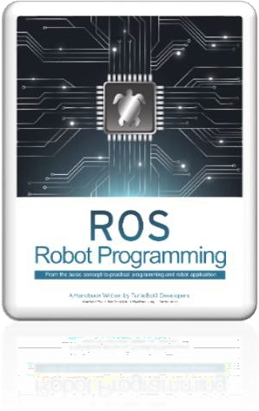
Contents
Introduction to Deep-Reinforcement Learning (Deep RL)
Libraries and Environment Setup
Example in OpenAI Gym environment
School of Global Convergence Studies

Slide 4
Introduction to Deep
Reinforcement Learning

Slide 5
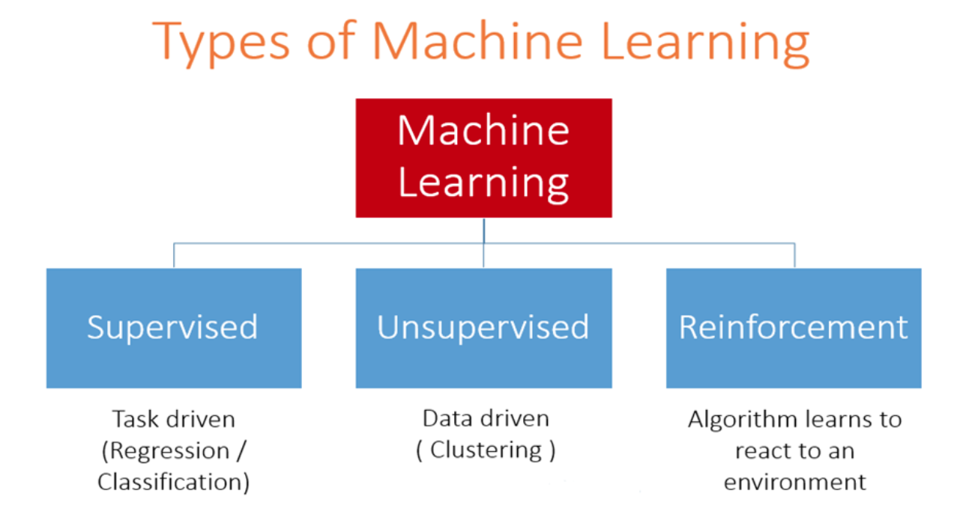
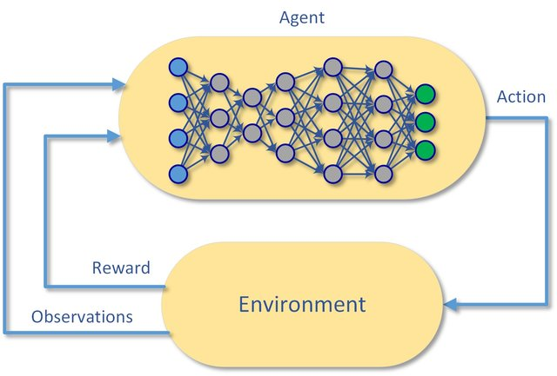
Introduction to Deep RL
Deep Reinforcement Learning
a subfield of machine learning
Reinforcement Learning + Deep Learning
considers the problems of computational agent learning to make decisions by trial and error
this algorithms can take in very large inputs and decide what actions to perform an objective.
its applications is not limit with robotics but also has been used for video-games, natural language processing, computer vision, education, transportation, finance and healthcare
Deep-Reinforcement learning
School of Global Convergence Studies
source:
https://miro.medium.com/max/1400/1*iWjbIValN-tXJ7sMQK1VSQ.png
https://imgur.com/gsXfI91

Slide 6
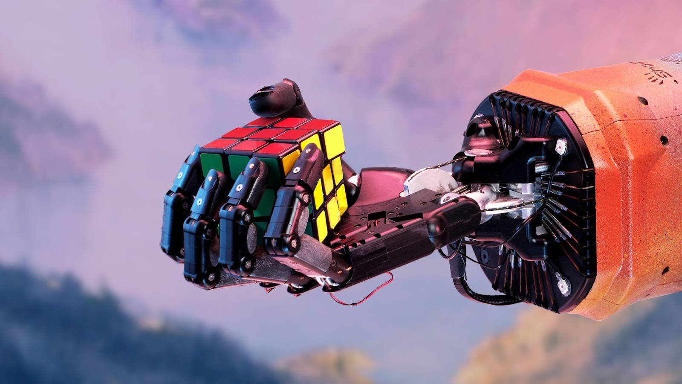
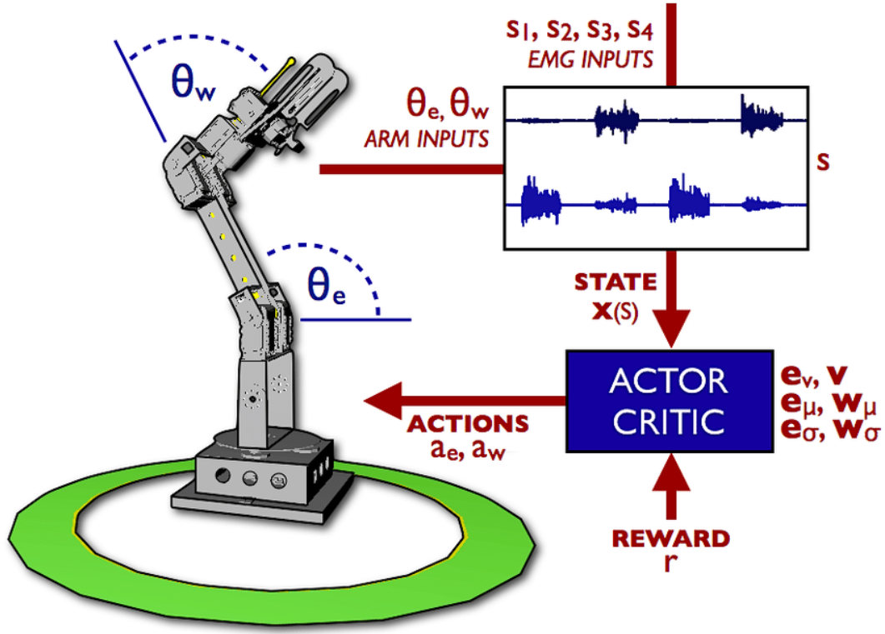
Introduction to Deep RL
Robots
Using computer vision and natural language processing or speech recognition using deep learning techniques has added human-like perceptions to autonomous robots. Further, combined deep learning and reinforcement learning methods have resulted in teaching robots to learn human-like gaits to walk, pick-up and manipulate objects, or observe human behavior through cameras and learn to perform like humans.
School of Global Convergence Studies
source:
https://149695847.v2.pressablecdn.com/wp-content/uploads/2021/02/image-1.png
https://www.researchgate.net/profile/Patrick-Pilarski/publication/221775753/figure/fig5/AS:667041627381763@1536046525074/A-schematic-diagram-of-actor-critic-reinforcement-learning-applied-to-a-two-joint-robotic.ppm

Slide 7
II. Libraries and
Environment Setup

Slide 8

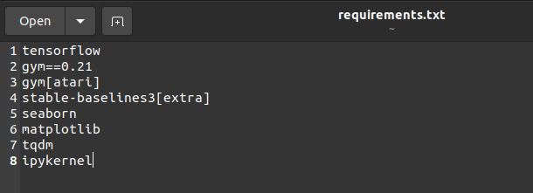
Libraries and Environment Setup
Create a new virtual environment called `deep_rl` and activate it
Install Jupyter Notebook
Install requirements
Install kernelspec deep_rl
Open Jupyter Notebook
School of Global Convergence Studies

Slide 9
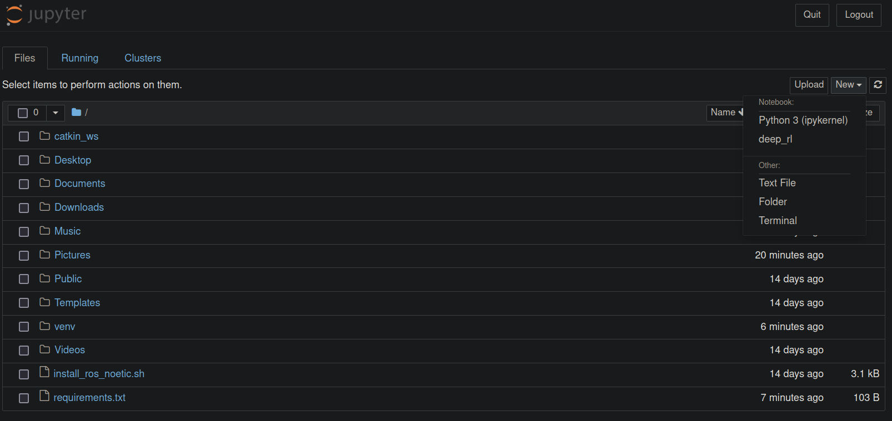
Libraries and Environment Setup
Jupyter Notebook
There is two kernel:
`Python3` is deafult kernel
`deep_rl` is our created kernel
You can create text file, folder or open a new terminal by this
Click `deep_rl` to make a new notebook
School of Global Convergence Studies

Slide 10
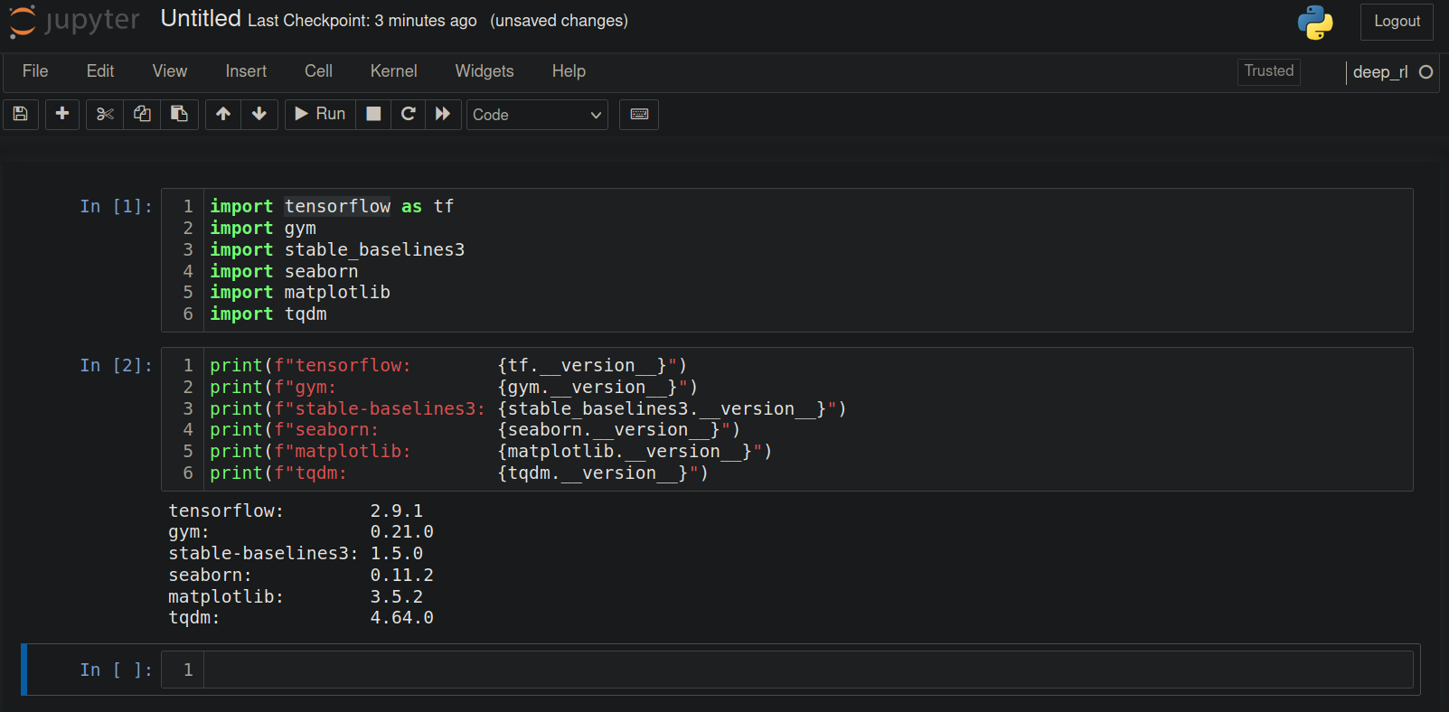
Libraries and Environment Setup
Check all installed libraries
You can check which kernel you are using now
School of Global Convergence Studies

Slide 11
III. Example in OpenAI
Gym Environments

Slide 12
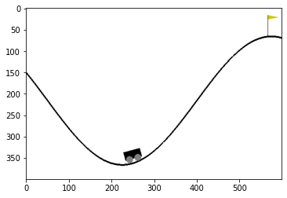
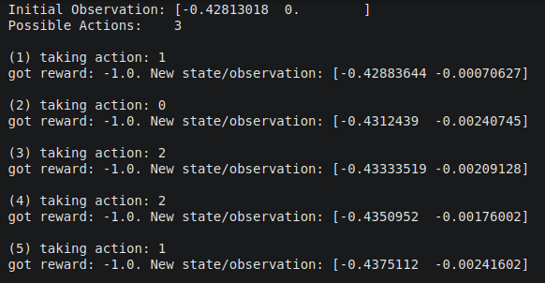
Example in OpenAI Gym Environments
Env: MountainCar-v0
obs, reward, done, info = env.step(action)
Action execution will return new `obs`, `reward`, `done` flag and `info`.
`done` flag is true obly when game ends
`info` provides some diagnostic information
(refer to 02 test-on-environment.ipynb)
School of Global Convergence Studies

Slide 13
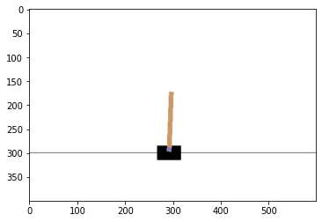
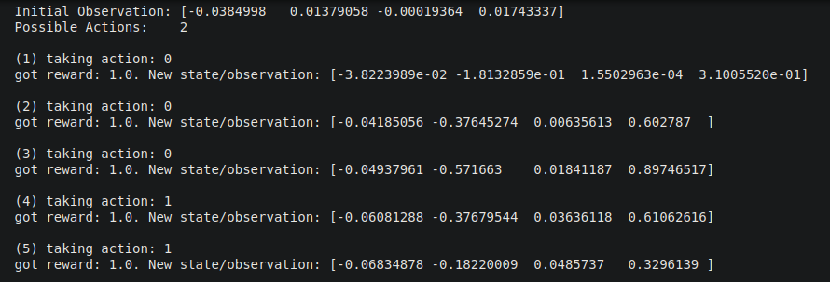
Example in OpenAI Gym Environments
Env: CartPole-v1
obs, reward, done, info = env.step(action)
Action execution will return new `obs`, `reward`, `done` flag and `info`.
`done` flag is true obly when game ends
`info` provides some diagnostic information
(refer to 02 test-on-environment.ipynb)
School of Global Convergence Studies

Slide 14
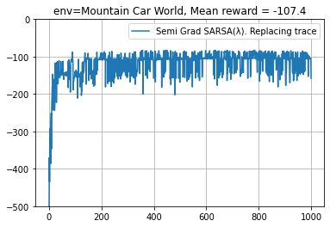
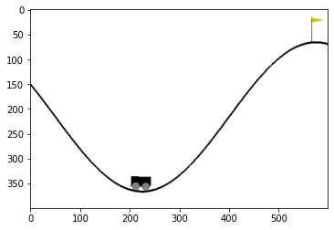
Example in OpenAI Gym Environments
Train n-SARSA Learning Agent
# environment
env_name = “MountainCar-v0”
# maximum episode steps
env._max_episode_steps = 500
# train steps
episode_cnt = 1000
After around 100 train steps, agent showed relatively similar results (approximately 90~150 steps)
*(refer to reinforcement-learning-intro.ipynb)
School of Global Convergence Studies

Slide 15
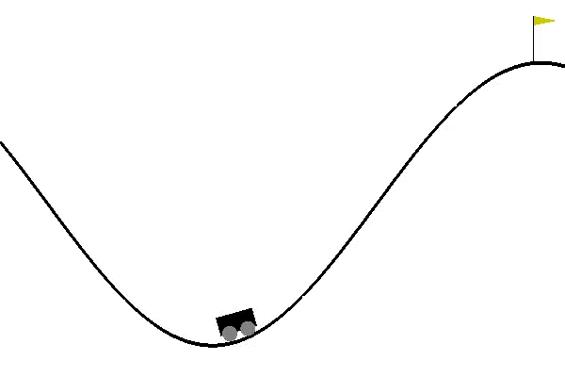
Example in OpenAI Gym Environments
Results
Records animation of the agent actions
School of Global Convergence Studies

